Slide 1
The Market Forces of Supply and Demand

Slide 2
DEMAND
Quantity demanded is the amount of a good that buyers are willing and able to purchase at a price.
Law of Demand
  The law of demand states that, other things equal (ceteris paribus), the quantity demanded of a good falls when the price of the good rises and vice versa.
Notes:
8

Slide 3
The Demand Curve : The Relationship Between Price & Quantity Demanded
Demand Schedule
  The demand schedule is a table that shows the relationship between the price of the good and the quantity demanded ( at different prices ).
Notes:
17

Slide 4
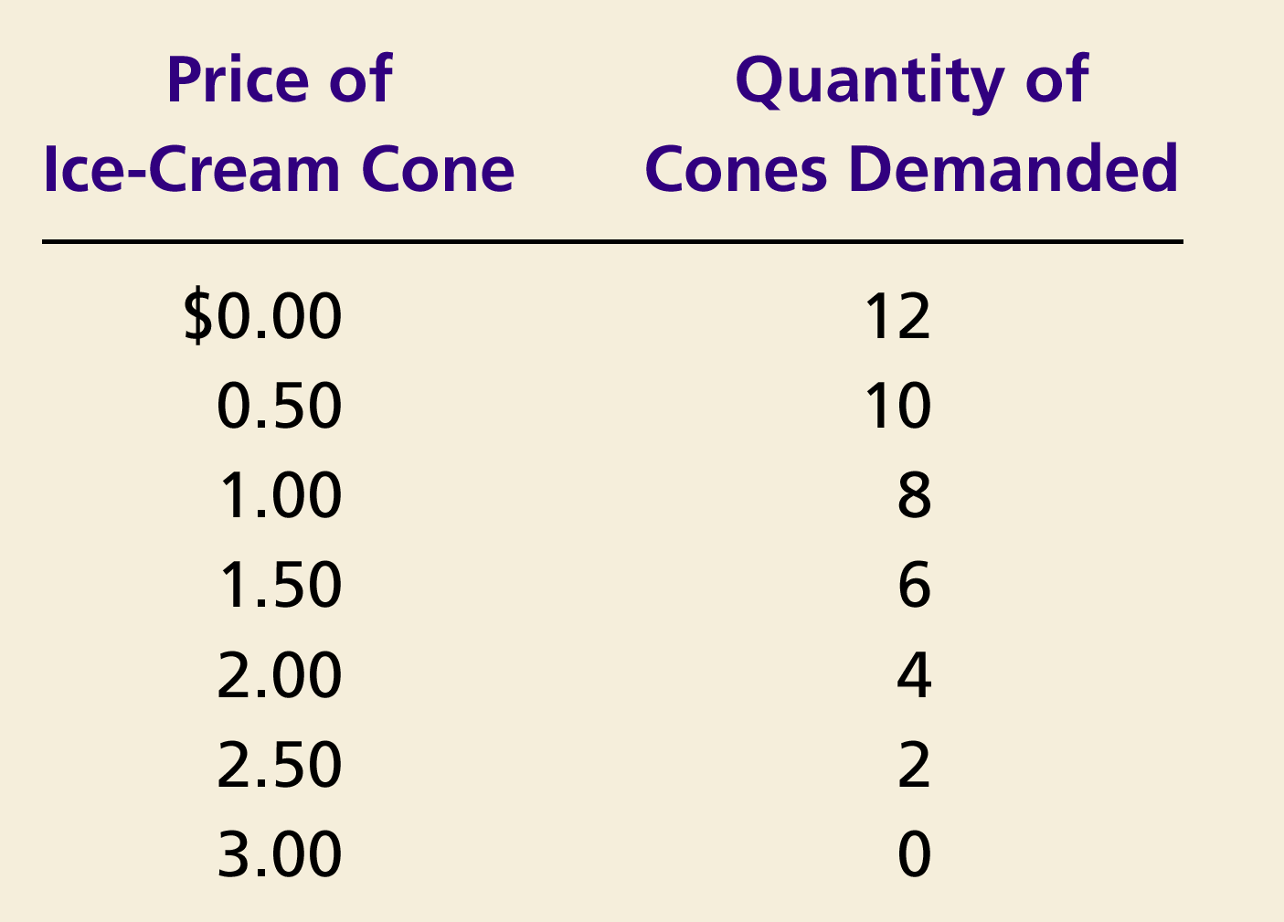
Rita’s Demand Schedule
Notes:
17

Slide 5
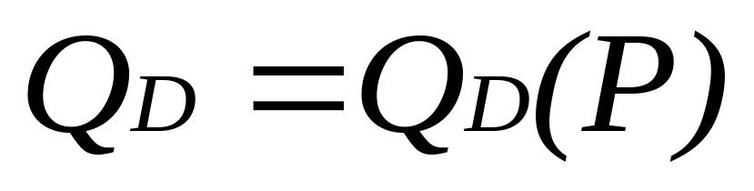
The Demand Curve : The Relationship Between Price & Quantity Demanded
Demand Curve
  The demand curve is a graph of the relationship between the price of a good and the quantity demanded. It depicts the demand schedule graphically.
Notes:
17

Slide 6
Demand
Price
(Rs per unit)
Vertical axis measures
price (P) paid
per unit in rupees
Horizontal axis measures
quantity (Q) demanded in
number of units per
time period
Quantity
Notes:
9

Slide 7
Demand
Price
(Rs per unit)
The demand curve slopes
downward demonstrating
that consumers are willing
to buy more at a lower price
as the product becomes
relatively cheaper and the
consumer’s real income
increases.
D
Quantity
Notes:
10

Slide 8

Figure 1 : Demand Schedule and Demand Curve
Price of
Ice-Cream Cone
$3.00
2.50
1. A decrease
2.00
in price
...
1.50
1.00
0.50
0
1
2
3
4
5
6
7
8
9
10
11
12
Quantity of
Ice-Cream Cones
2.
...
increases quantity
of cones demanded.

Slide 9
Market Demand Vs Individual Demand
Market demand refers to the sum of all individual demands for a particular good or service.
Graphically, individual demand curves are summed horizontally to obtain the market demand curve.

Slide 10
Movement Along The Demand Curve
Change in Quantity Demanded
  Movement along the demand curve.
  Caused by a change in the price of the product.
  - All other variables are held constant.
Notes:
19

Slide 11
Changes in Quantity Demanded
Price of Ice-Cream
Cones
A tax that raises the price of ice-cream cones results in a movement along the demand curve.
B
$2.00
A
1.00
D
0
4
8
Quantity of Ice-Cream Cones
Notes:
Polythene sacks-gst increase from 12 to 18%; woven and non woven fabrics-12% to 18%; mobile phones- 12 to 18%. Gst rates decreased on covid and black fungus related medicines to either 5% or nil. Restaurant meals gst reduced from 12% to 5%.

Slide 12
Shifts In The Demand Curve
Change in Demand
  A shift in the demand curve, either to the left or right.
  Caused by any change that alters the quantity demanded at every price.
Notes:
19

Slide 13
Figure 3 : Shifts in the Demand Curve
Price of
Ice-Cream
Cone
Increase
in demand
Decrease
in demand
Demand
curve,
D
2
Demand
curve,
D
1
Demand curve,
D
3
0
Quantity of
Ice-Cream Cones

Slide 14
Shifts In The Demand Curve
    Consumer income
    Prices of related goods
    Tastes
    Expectations
    Number of buyers
Notes:
11

Slide 15
Shifts In The Demand Curve
Consumer Income
  As income increases the demand for a good will increase.

Slide 16
Effect Of Consumer Income On Demand
Price of Ice-Cream Cone
$3.00
An increase in income...
2.50
Increase
in demand
2.00
1.50
1.00
0.50
D₂
D₁
Quantity of Ice-Cream Cones
0
1
2
3
4
5
6
7
8
9
10
11
12

Slide 17
Shifts In The Demand Curve
Prices of Related Goods
  When a fall in the price of one good reduces the demand for another good, the two goods are called substitutes.
  When a fall in the price of one good increases the demand for another good, the two goods are called complements.

Slide 18
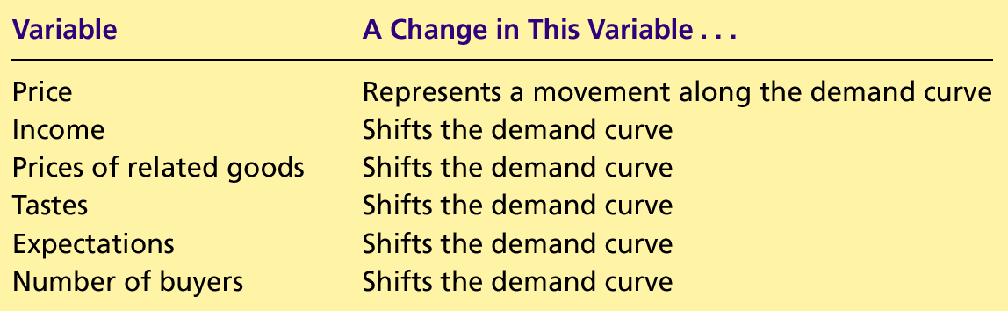
Table 1: Variables That Influence Buyers

Slide 19
SUPPLY
Quantity supplied is the amount of a good that sellers are willing and able to sell at a price.
Law of Supply
  The law of supply states that, other things equal (ceteris paribus), the quantity supplied of a good rises when the price of the good rises and vice versa.
Notes:
25

Slide 20
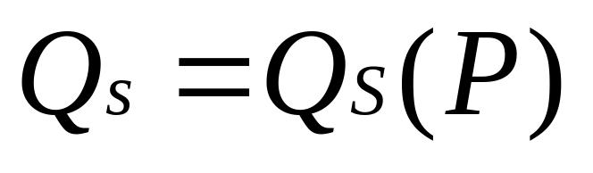
The Supply Curve : The Relationship Between Price & Quantity Supplied
Supply Schedule
  The supply schedule is a table that shows the relationship between the price of the good and the quantity supplied (at different prices).
Notes:
29

Slide 21
Raj’s Supply Schedule
Price of Quantity of
Ice-cream cone cones supplied
$0.00 0
0.50 0
1.00 1
1.50 2
2.00 3
2.50 4
3.00 5
Notes:
29

Slide 22
The Supply Curve : The Relationship Between Price & Quantity Supplied
Supply Curve
  The supply curve is the graph of the relationship between the price of a good and the quantity supplied. It depicts the supply schedule graphically.
Notes:
29

Slide 23
Supply
The Supply
Curve Graphically
Price
(Rs per unit)
Vertical axis measures
price (P) received
per unit in rupees
Horizontal axis measures
quantity (Q) supplied in
number of units per
time period
Quantity
Notes:
6

Slide 24
Supply
The Supply
Curve Graphically
Price
(Rs per unit)
S
P₂
The supply curve slopes
upward demonstrating that
at higher prices firms
will increase output
P₁
Q₁
Q₂
Quantity
Notes:
7

Slide 25
Figure 5: Raj’s Supply Schedule and Supply Curve
Price of
Ice-Cream
Price of Quantity of
Ice-cream cone cones supplied
$0.00 0
0.50 0
1.00 1
1.50 2
2.00 3
2.50 4
3.00 5
Cone
$3.00
2.50
1. An
increase
in price
...
2.00
1.50
1.00
0.50
0
1
2
3
4
5
6
7
8
9
10
11
12
Quantity of
Ice-Cream Cones
2.
...
increases quantity of cones supplied.

Slide 26
Market Supply Vs Individual Supply
Market supply refers to the sum of all individual supplies for all sellers of a particular good or service.
Graphically, individual supply curves are summed horizontally to obtain the market supply curve.

Slide 27
Movement Along The Supply Curve
Change in Quantity Supplied
  Movement along the supply curve.
  Caused by a change in the price of the product.
  All other variables affecting supply are kept constant.
Notes:
30

Slide 28
Change in Quantity Supplied
Price of Ice-Cream Cone
S
C
$3.00
A rise in the price of ice cream cones results in a movement along the supply curve.
A
1.00
Quantity of Ice-Cream Cones
0
1
5
Notes:
30

Slide 29
Shifts In The Supply Curve
Change in Supply
  A shift in the supply curve, either to the left or right.
  Caused by a change in a determinant other than price.
Notes:
30

Slide 30
Figure 7 : Shifts in the Supply Curve
Price of
Ice-Cream
Supply curve,
S
3
Supply
Cone
curve,
S
1
Supply
Decrease
curve,
S
2
in supply
Increase
in supply
0
Quantity of
Ice-Cream Cones

Slide 31
Shifts In The Supply Curve
Input prices
Technology
Expectations
Number of sellers
Notes:
27

Slide 32
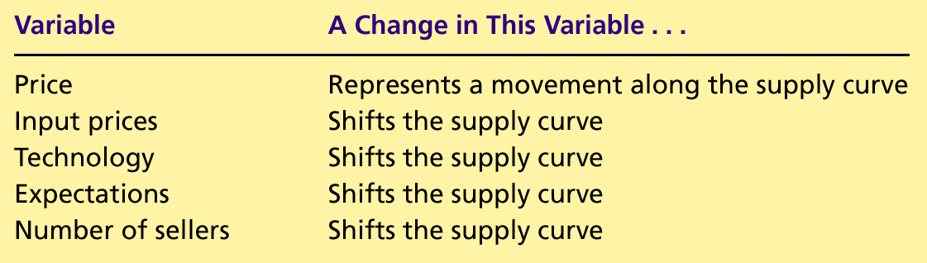
Table 2: Variables That Influence Sellers

Slide 33
SUPPLY AND DEMAND TOGETHER
Equilibrium refers to a situation in which the price has reached the level where quantity supplied equals quantity demanded.
Equilibrium gives market clearing price and quantity.
Notes:
36

Slide 34
SUPPLY AND DEMAND TOGETHER
Equilibrium Price
  The price that balances quantity supplied and quantity demanded.
  On a graph, it is the price at which the supply and demand curves intersect.
Equilibrium Quantity
  The quantity supplied and the quantity demanded at the equilibrium price.
  On a graph it is the quantity at which the supply and demand curves intersect.
Notes:
36

Slide 35
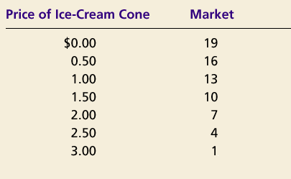
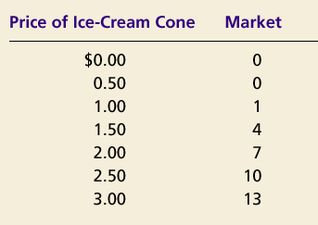
SUPPLY AND DEMAND TOGETHER
Demand Schedule
Supply Schedule
At $2.00, the quantity demanded is equal to the quantity supplied!
Notes:
36

Slide 36
Figure 8: The Equilibrium of Supply and Demand
Price of
Ice-Cream
Cone
Supply
Equilibrium price
Equilibrium
$2.00
Equilibrium
Demand
quantity
0
1
2
3
4
5
6
7
8
9
10
11
12
13
Quantity of Ice-Cream Cones

Slide 37
Figure 9 : Markets Not in Equilibrium
(a) Excess Supply
Price of
Ice-Cream
Supply
Cone
Surplus
$2.50
2.00
Demand
0
4
7
10
Quantity of
Quantity
Quantity
Ice-Cream
demanded
supplied
Cones

Slide 38
EQUILIBRIUM
Surplus
  When price > equilibrium price, then quantity supplied > quantity demanded.
    There is excess supply or a surplus.
    Suppliers will lower the price to increase sales, thereby moving toward equilibrium.

Slide 39
Figure 9 : Markets Not in Equilibrium
(b) Excess Demand
Price of
Ice-Cream
Supply
Cone
$2.00
1.50
Shortage
Demand
0
4
7
10
Quantity of
Quantity
Quantity
Ice-Cream
supplied
demanded
Cones

Slide 40
EQUILIBRIUM
Shortage
  When price < equilibrium price, then quantity demanded > the quantity supplied.
    There is excess demand or a shortage.
    Suppliers will raise the price due to too many buyers chasing too few goods, thereby moving toward equilibrium.

Slide 41
EQUILIBRIUM
  The condition that the price of any good adjusts to bring the quantity supplied and the quantity demanded for that good into balance.

Slide 42
Three Steps To Analysing Changes In Equilibrium
Determine whether the event shifts the supply or demand curve (or both).
Determine whether the curve(s) shift(s) to the left or to the right.
Use the supply-and-demand diagram to see how the shift affects equilibrium price and quantity.
Notes:
45

Slide 43
Figure 10 : How an Increase in Demand Affects the Equilibrium
Price of
Ice-Cream
1. Hot weather increases
Cone
the demand for ice cream . . .
Supply
$2.50
New equilibrium
2.00
2. . . . resulting
Initial
in a higher
equilibrium
price . . .
D
D
0
7
10
Quantity of
3.
. . .
and a higher
Ice-Cream Cones
quantity sold.

Slide 44
Three Steps To Analysing Changes In Equilibrium
Shifts in Curves versus Movements along Curves
  A shift in the supply curve is called a change in supply.
  A movement along a fixed supply curve is called a change in quantity supplied.
  A shift in the demand curve is called a change in demand.
  A movement along a fixed demand curve is called a change in quantity demanded.

Slide 45
Figure 11: How a Decrease in Supply Affects the Equilibrium
Price of
Ice-Cream
1. An increase in the
Cone
price of sugar reduces
S₂
the supply of ice cream. . .
S₁
New
$2.50
equilibrium
2.00
Initial equilibrium
2. . . . resulting
in a higher
price of ice
cream . . .
Demand
0
4
7
Quantity of
3.
. . .
and a lower
Ice-Cream Cones
quantity sold.

Slide 46
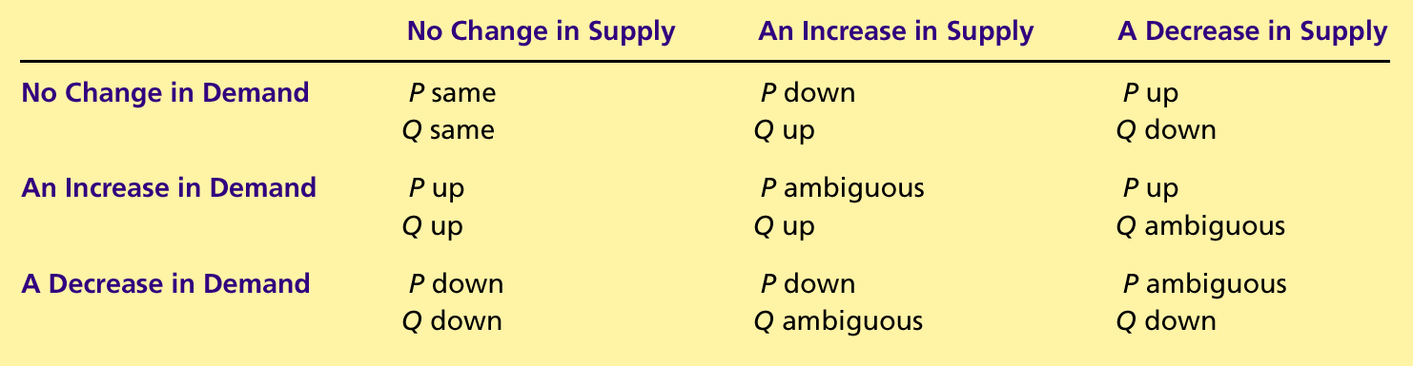
Table 4 : What Happens to Price and Quantity When Supply or Demand Shifts?

Slide 47
Shifts in Supply and Demand
When supply and demand change simultaneously, the impact on the equilibrium price and quantity is determined by:
1) The relative size and direction of the change
2) The shape of the supply and demand models
Notes:
50

Slide 48
Example : The Price of Gold
The real price of gold has risen sharply from 2000 to 2020.
Supply decreased due to shortfall in global production.
Demand increased due to the fact that investing in gold is considered safe as compared to other assets.
Notes:
55

Slide 49
Example : Market for Gold
S₂₀₂₀
P
P₂₀₂₀
S₂₀₀₀
P₂₀₀₀
D₂₀₂₀
D₂₀₀₀
Q₂₀₀₀
Q₂₀₂₀
Q
Notes:
58

Slide 50
Ever-falling prices
One overriding characteristic of all consumer electronic products is the trend of ever-falling prices. This is driven by gains in manufacturing efficiency and automation, lower labor costs as manufacturing has moved to lower-wage countries, and improvements in semiconductor design. Semiconductor components benefit from Moore's Law, an observed principle which states that, for a given price, semiconductor functionality doubles every two years.
Due to this, despite rising incomes and increasing demand for such products, their prices are falling.

Slide 51
Elasticity and Its Applications

Slide 52
Elasticity . . .
… allows us to analyze supply and demand with greater precision.
… is a measure of how much buyers and sellers respond to changes in market conditions.

Slide 53
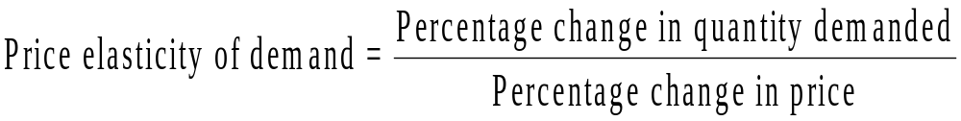
Computing The Price Elasticity Of Demand
The price elasticity of demand is computed as the percentage change in the quantity demanded divided by the percentage change in price.

Slide 54
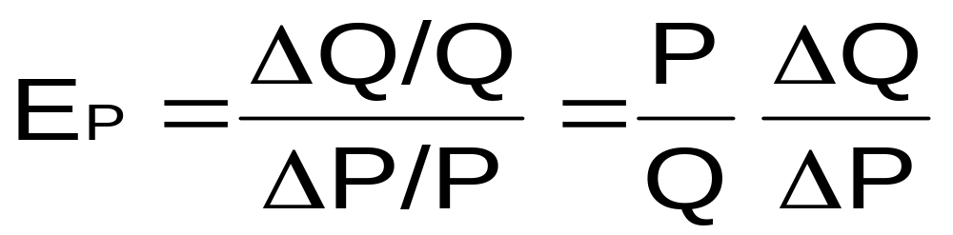
THE ELASTICITY OF DEMAND
Price elasticity of demand is a measure of how much the quantity demanded of a good responds to a change in the price of that good.
Price elasticity of demand is the percentage change in quantity demanded given a percent change in the price.

Slide 55
The Variety Of Demand Curves
Because of the inverse relationship between P and Q; E_{P} is always negative, whether explicitly stated or not.
Inelastic Demand
  Quantity demanded does not respond strongly to price changes.
  Price elasticity of demand is less than one ( E_{P} < 1 ).
Elastic Demand
  Quantity demanded responds strongly to changes in price.
  Price elasticity of demand is greater than one ( E_{P} > 1 ).
Perfectly Inelastic Demand
  Quantity demanded does not respond to price changes.
  Ep = 0

Slide 56
The Price Elasticity Of Demand & Its
Determinants
Availability of Close Substitutes
Necessities versus Luxuries
Definition of the Market
Time Horizon

Slide 57
Price Elasticity Of Demand And Its
Determinants
Demand tends to be more elastic :
  the larger the number of close substitutes.
  if the good is a luxury.
  the more narrowly defined the market.
  the longer the time period.

Slide 58
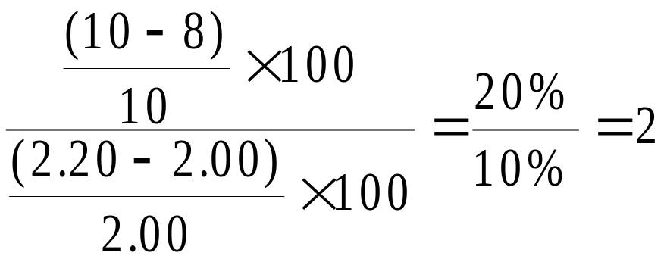
Computing The Price Elasticity Of Demand
Example: If the price of an ice cream cone increases from $2.00 to $2.20 and the amount you buy falls from 10 to 8 cones, then your elasticity of demand would be calculated as:
Point elasticity formula

Slide 59
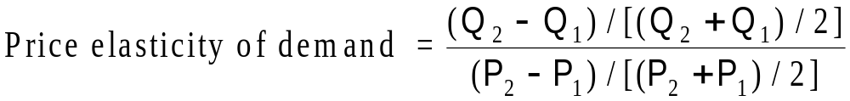
The Midpoint Method : A Better Way To
Calculate Elasticities
The midpoint formula is preferable when calculating the price elasticity of demand because it gives the same answer regardless of the direction of the change.

Slide 60
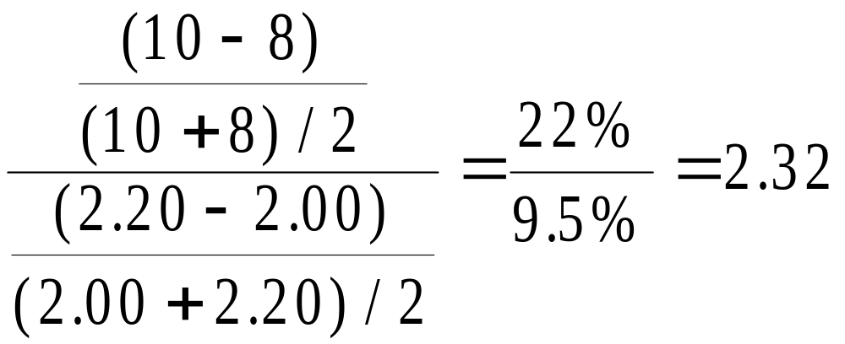
The Midpoint Method : A Better Way To Calculate Elasticities
Example: If the price of an ice cream cone increases from $2.00 to $2.20 and the amount you buy falls from 10 to 8 cones, then your elasticity of demand, using the midpoint formula, would be calculated as:

Slide 61
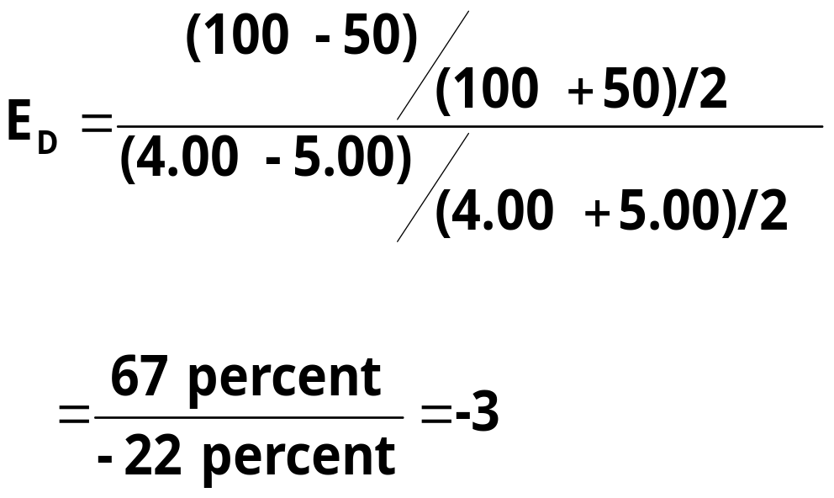
Computing The Price Elasticity Of Demand
Price
$5
4
Demand
0
50
100
Quantity
Demand is price elastic

Slide 62
The Variety Of Demand Curves
Perfectly Inelastic
  Quantity demanded does not respond to price changes.
Perfectly Elastic
  Quantity demanded changes infinitely with any change in price.
Unit Elastic
  Quantity demanded changes by the same percentage as the price.

Slide 63
The Variety Of Demand Curves
Because the price elasticity of demand measures how much quantity demanded responds to the price, it is closely related to the slope of the demand curve.
But it is NOT the slope.

Slide 64
Figure 1 : The Price Elasticity of Demand
(a) Perfectly Inelastic Demand: Elasticity Equals 0
Price
Demand
$5
4
1. An
increase
in price . . .
0
100
Quantity
2. . . . leaves the quantity demanded unchanged.

Slide 65
Figure 1 : The Price Elasticity of Demand
(b) Inelastic Demand: Elasticity Is Less Than 1
Price
$5
4
1. A 22%
Demand
increase
in price . . .
0
90
100
Quantity
2. . . . leads to an 11% decrease in quantity demanded.

Slide 66
Figure 1 : The Price Elasticity of Demand
(c) Unit Elastic Demand: Elasticity Equals 1
Price
$5
4
1. A 22%
Demand
increase
in price . . .
0
80
100
Quantity
2. . . . leads to a 22% decrease in quantity demanded.

Slide 67
Figure 1 : The Price Elasticity of Demand
(d) Elastic Demand: Elasticity Is Greater Than 1
Price
$5
4
Demand
1. A 22%
increase
in price . . .
0
50
100
Quantity
2. . . . leads to a 67% decrease in quantity demanded.

Slide 68
Figure 1 : The Price Elasticity of Demand
(e) Perfectly Elastic Demand: Elasticity Equals Infinity
Price
1. At any price
above $4, quantity
demanded is zero.
$4
Demand
2. At exactly $4,
consumers will
buy any quantity.
0
Quantity
3. At a price below $4,
quantity demanded is infinite.

Slide 69
Total Revenue & The Price Elasticity
Of Demand
Total revenue is the amount paid by buyers and received by sellers of a good.
Computed as the price of the good times the quantity sold.
TR = P x Q

Slide 70
Figure 2 : Total Revenue
Price
$4
P × Q = $400
P
(revenue)
Demand
0
100
Quantity
Q

Slide 71
Elasticity & Total Revenue Along A
Linear Demand Curve
With an inelastic demand curve, an increase in price leads to a decrease in quantity that is proportionately smaller. Thus, total revenue increases.

Slide 72
Figure 3 : How Total Revenue Changes When Price Changes: Inelastic Demand
Price
Price
An Increase in price from $1
to $3 …
… leads to an Increase in total revenue from $100 to $240
$3
Revenue = $240
$1
Revenue = $100
Demand
Demand
0
100
Quantity
0
80
Quantity

Slide 73
Elasticity & Total Revenue Along A
Linear Demand Curve
With an elastic demand curve, an increase in the price leads to a decrease in quantity demanded that is proportionately larger. Thus, total revenue decreases.

Slide 74
Figure 4 : How Total Revenue Changes When Price Changes: Elastic Demand
Price
Price
An Increase in price from $4
to $5 …
… leads to an decrease in total revenue from $200 to $100
$5
$4
Demand
Demand
Revenue = $200
Revenue = $100
0
50
Quantity
0
20
Quantity

Slide 75
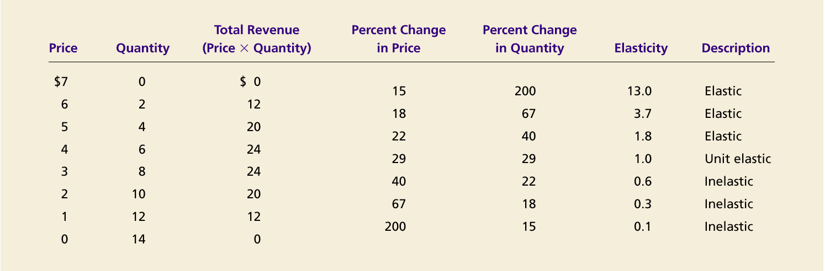
Elasticity of a Linear Demand Curve
Percentage change in quantity and price have been calculated using the arc formula.
Notes:
Q = 14 – 2P

Slide 76

Price Elasticities of Demand Along A Linear Demand Curve
Price
The lower portion of
a downward sloping
demand curve is less elastic
than the upper portion.
4
Q = 8 - 2P
E_{p} = -1
2
Linear Demand Curve
Q = a - bP
Q = 8 - 2P
E_{p} = 0
4
8
Q
Notes:
76

Slide 77
Income Elasticity Of Demand
Income elasticity of demand measures how much the quantity demanded of a good responds to a change in consumers’ income.
It is computed as the percentage change in the quantity demanded divided by the percentage change in income.

Slide 78
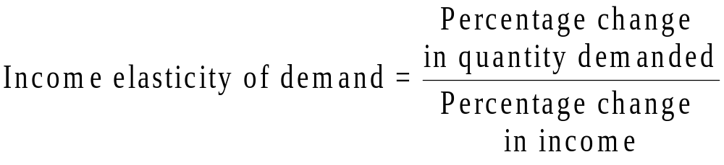
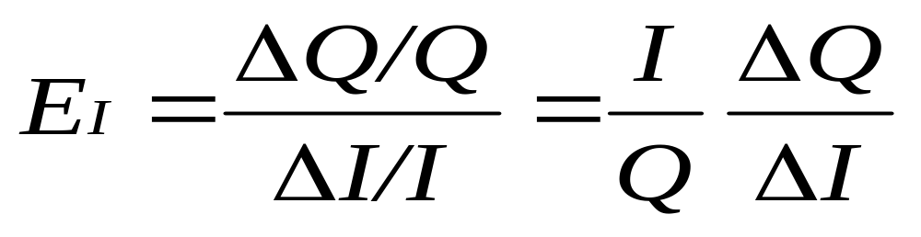
Computing Income Elasticity

Slide 79
Income Elasticity Of Demand
Types of Goods
  Normal Goods
  Inferior Goods
Higher income raises the quantity demanded for normal goods but lowers the quantity demanded for inferior goods.

Slide 80
Income Elasticity Of Demand
Goods consumers regard as necessities tend to be income inelastic
  Examples include food, fuel, clothing, utilities, and medical services.
Goods consumers regard as luxuries tend to be income elastic.
  Examples include sports cars, furs, and expensive foods, expensive clothes.
  Income elasticity > 1 : normal – Income elastic goods
  Income elasticity > 0, and <1 : normal - income inelastic goods
  Income elasticity < 0 : inferior goods

Slide 81
THE ELASTICITY OF SUPPLY
Price elasticity of supply is a measure of how much the quantity supplied of a good responds to a change in the price of that good.
Price elasticity of supply is the percentage change in quantity supplied resulting from a percent change in price.
The elasticity is positive because price and
quantity supplied are directly related.

Slide 82
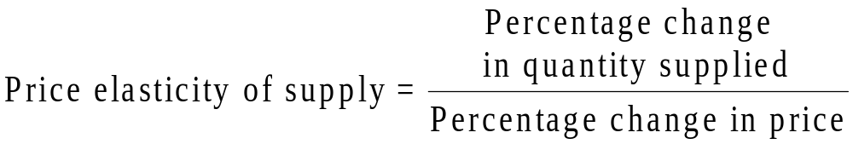
Computing The Price Elasticity Of
Supply
The price elasticity of supply is computed as the percentage change in the quantity supplied divided by the percentage change in price.

Slide 83
Determinants Of Price Elasticity
Of Supply
Ability of sellers to change the amount of the good they produce.
  Beach-front land is inelastic.
  Books, cars, or manufactured goods are elastic.
Time period.
  Supply is more elastic in the long run.
Notes:
Because firms often have a maximum capacity for production, the elasticity of supply may be very high at low levels of quantity supplied and very low at high levels of quantity supplied.

Slide 84
Other Demand Elasticities
Cross elasticity of demand measures the percentage change in the quantity demanded of one good that results from a one percent change in the price of another good.
For example consider the substitute goods, butter and margarine.
Notes:
81

Slide 85
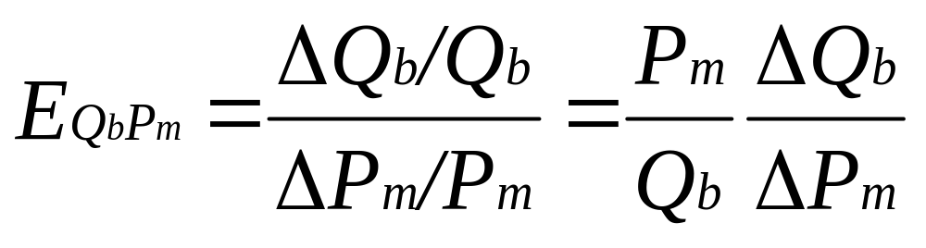
Other Demand Elasticities
The cross elasticity of demand is:
The cross elasticity for substitutes is positive, while that for complements is negative.
Notes:
83

Slide 86
Example
Suppose the demand curve for a product is given by –
Q = 10 – 2P + P_{S}
where P is the price of the product and P_{S} is the price of a substitute good. The price of the substitute good is Rs. 20.
a) Suppose P = Rs.10. what is the price elasticity of demand? What is the cross price elasticity of demand?
Suppose the price of good, P, falls to Rs.5. Now what is the price elasticity of demand? What is the cross price elasticity of demand?

Slide 87
International Video Machines, Inc., is a manufacturer of a television video-recording device. The firm is considering lowering the price of its product from $800 to $600. The company’s market analysts have estimated the price elasticity of demand to be -2 over this price range. Presently, this firm sells 1,000 video recorders per month.
  a) What will be the new quantity sold if the price is lowered to $600?
  b) What will be the new level of total revenue in Part a?
  c) What additional information does International Video Machines, Inc., need to know before it can determine whether or not a price decrease will increase the firm’s profit?
  d) Suppose that after International Video Machines lower its price, its competitor, Videoview, lowers the price of its machine from $900 to $800. The cross price elasticity of demand between the quantity sold of International Video Machines’ video recorders and the price of Videoview’s machine is 0.5. What will be the effect of Videoview’s price decrease on the quantity sold by International Video Machines? (Use the quantity you found in part a) as Q1. Round your answer to the nearest whole number).
[Note: Use arc elasticity concepts for answering parts (a) and (d)].

Slide 88
Example
Suppose that the short-run world demand and supply elasticities for crude oil are :- -0.076 and 0.088, respectively. The current price per barrel is $30 and the short-run equilibrium quantity is 23.84 billion barrels per year. Derive the linear demand and supply equations.

Slide 89
Example
American Mining Company is interested in obtaining quick estimates of the supply and demand curves for coal. The firm's research department informs you that the elasticity of supply is approximately 1.7, the elasticity of demand is approximately -0.85, and the current price and quantity are $41 and 1,206, respectively. Price is measured in dollars per ton, quantity the number of tons per week.
a) Estimate linear supply and demand curves at the current price and quantity.
b) What impact would a 10% increase in demand have on the equilibrium price and quantity?
c) If the government refused to let American raise the price when demand increased in (b) above, what shortage is created?

Slide 90
ELASTICITY CONCEPTS
A publisher of novels hires an economist to find out the demand for its product. The analyst submits that the demand for publisher’s novels (Qx) is given by the equation :
Qx = 12000 – 5000Px + 5I + 500Pc
where Px = price of novels
I = income per capita
Pc = price of books from competitors
Using this information, the publishing house manager wants to –
a) determine what effect a price increase would have on total revenues
b) evaluate how sale of novels would change during a period of rising incomes
c) assess the probable impact if competitors raise their prices.
Assume that initial values of Px, I, and Pc are $5, $10000 and $6 respectively.

Slide 91
ELASTICITY CONCEPTS
Explain why the govt of USA has resorted to setting up of rehabilitation centres to cure the menace of drug addiction instead of pricing drugs highly?

